Slide 2
culture
culture
culture
culture
culture
culture
…
culture
culture
…

Slide 3
culture
culture
culture
culture
culture
…
…

Slide 4
sample
sample
culture
sample
sample
…

Slide 5
culture
sample
Other cultures
…
sample

Slide 6




Sensitive yeasts
yeasts
Resistant yeasts

Slide 7
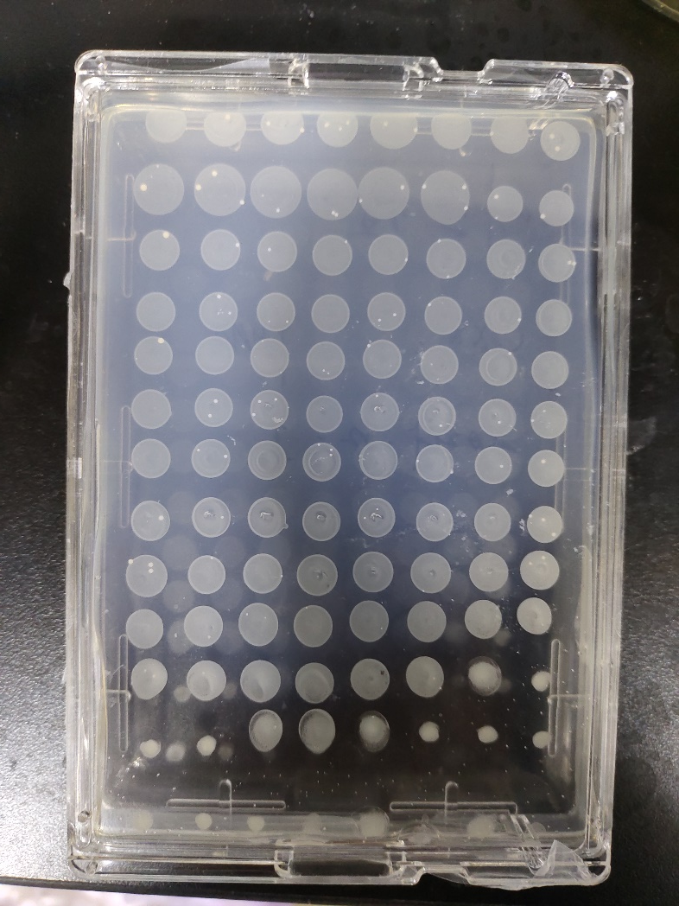
0
1
2
3
3
0
1
2
2
3
2
2
2
3
2
1
1
1
1
1
1
2
0
2
0
2
2
0
2
1
1
0
1
0
2
2
1
2
1
0
0
2
3
0
1
1
1
2
0
2
0
3
0
2
1
1
1
1
0
0
2
0
1
3
3
1
1
0
0
0
0
2
0
0
2
1
1
0
0
0

Slide 8
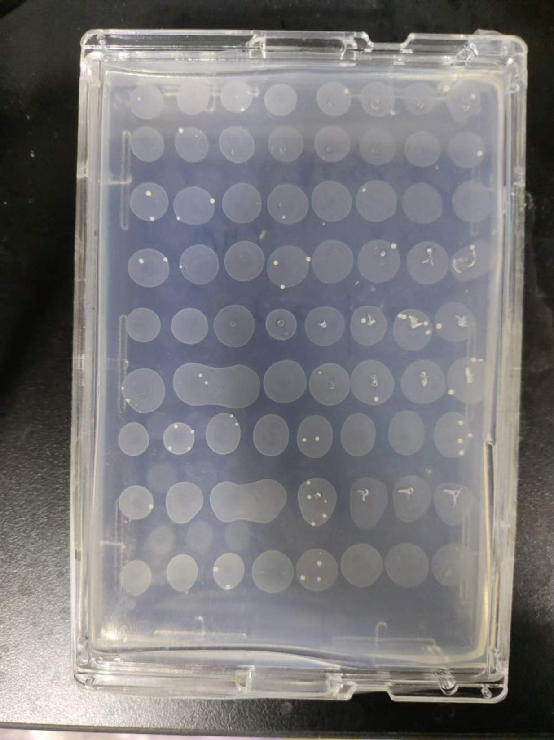
1
0
2
0
1
0
0
1
0
2
0
0
0
0
0
1
2
2
0
1
0
1
0
0
2
1
0
3
0
2
1
1
0
0
0
0
1
1
4
1
2
0
1
1
1
3
0
4
2
0
2
0
0
4
1
0
6
1
1
1
0
0
2
0
3
0
0
0

